Slide 1
Elements of Fiction
Wallace Middle School
7th Grade

Slide 3
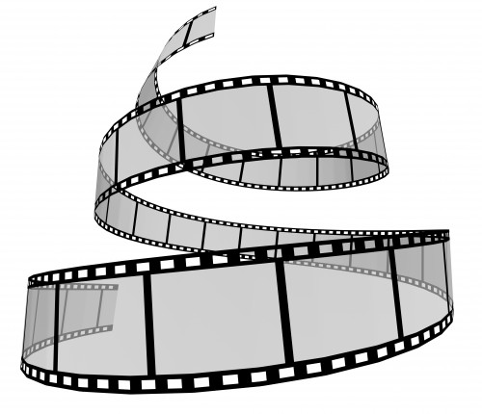
Plot
The plot is the series of events and actions that take place in a story.

Slide 4
Elements of Plot
Exposition
The start of the story. The way things are before the action starts.
Rising Action
The series of conflicts and crisis in the story that lead to the climax.
Climax
The turning point. The most intense moment.
Falling Action
All of the action which follows the climax.
Resolution (Denouement)
The conclusion. The tying together of all of the story.

Slide 5
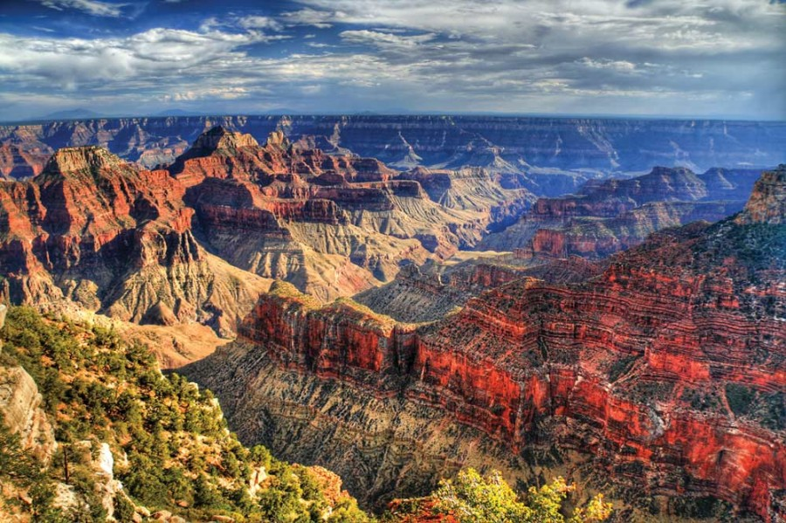
Setting
The time, place and period in which the action takes place.
A novel can have many different settings throughout.

Slide 6
Character
The people appearing in the work of fiction.

Slide 7
2 Types of Characters
Static Character
Stays the same throughout the story.
Dynamic Character
Undergoes some type of change in the story.

Slide 8
Conflict
Individual vs. Individual
Individual vs. Nature
Individual vs. Society
Individual vs. Himself or Herself

Slide 9
Theme
The theme of a piece of fiction is it’s central idea.
It can be a lesson that the author wants you to take away from the story.

