Slide 2
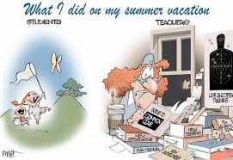
Objectives for This Session
To stress the importance of hands-on interactive activities in the classroom.
To provide teachers and specialists the opportunity to try a few interactive activities that work in middle level classrooms.
To provide teachers and specialists with materials and ideas that can be adapted for their classrooms.
Source: larrycuban.wordpress.com

Slide 3
New Students and Breaking Some Ice
Ever feel like you run a torture chamber?
“Welcome to my class. First we will go over the rules and supply list. And then we will take the mandatory pre-assessment. This process will take at least two days. Are there any questions?”
Source: theoddestbox.com

Slide 4
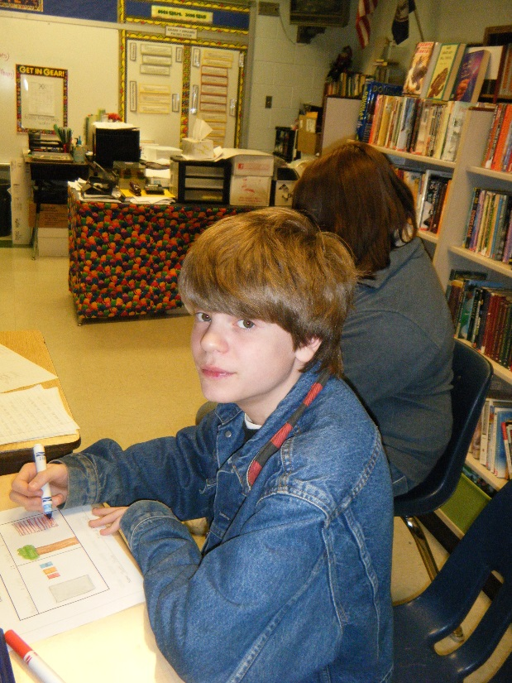
New Students and Breaking Some Ice
MULTIPLE INTELLIGENCES
Everybody is some kind of smart.
Take an inventory at the beginning of the year so you and your students can see where strengths and needs are.
When you group students, you can use the inventories to distribute talents so everyone collaborates more successfully.
© Lizbeth J. Phillips, all rights reserved

Slide 5
Complete a Multiple Intelligences Survey
Answer all the questions.
Total answers for each category.
Graph your results. (If you want to use colored pencils, go ahead!)
Display the percentages for each kind of Smart.
Source: www.dyslexickids.net

Slide 6
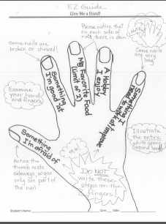
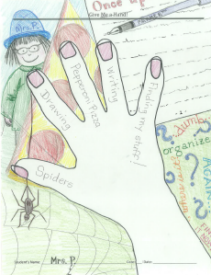
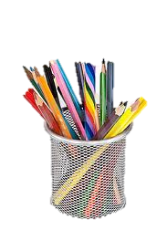
New Students and Breaking Some Ice
GIVE ME A HAND!
There’s one of you and maybe a hundred of them. You have to learn their names and get an idea of who your students are.
You have far too little time to learn little bits of trivia so you connect with your students in the very first days of class.
Give Me a Hand helps.
© Lizbeth J. Phillips

Slide 7
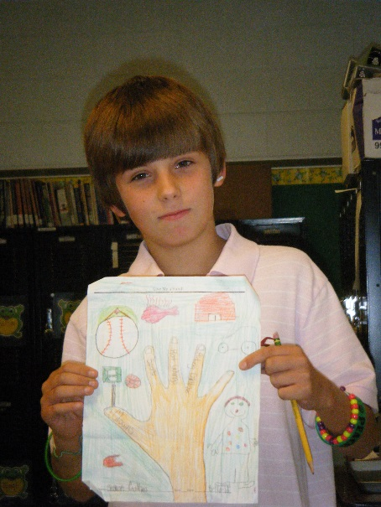
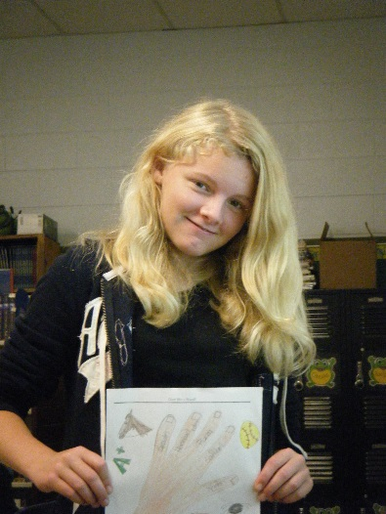
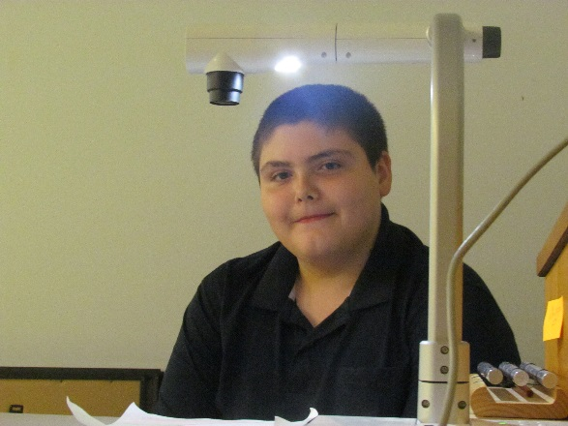
Create Your Own Hand!
Trace around your hand. Start at the wrist and go around hand, fingers spread out. Do nails!
Write important information on each finger.
Afraid of…
Good at…
Favorite food…
A hobby…
Something to work on/improve
Draw/Color so no white space is outside your hand.
Present yourself to the class!
© Lizbeth J. Phillips, all rights reserved

Slide 8
Get a Life!
Figurative language is difficult to identify if you are not a reader. Idioms and personification are not used as much in students’ everyday conversations.
We have more concrete learners than ever before—in spite of all the technology students have at their fingertips. Many of our students exist in poverty, and their casual language gets in the way of learning formal language concepts.
We have to become more explicit about figurative language so the world is not overflowing with Amelia Bedelias.
Source: blog.writeathome.com

Slide 9
Got Some Roots?
SORTS & GRAPHIC ORGANIZER
When we want students to really KNOW something and commit it to long-term memory, we have to get creative.
We are competing with video games and social networking. Students need visual and tactile activities to make it stick.
Manipulatives are hard to come by in middle level language arts!
A graphic organizer for practice is a good idea as well.
“I Have Who Has” games are always fun!
© Lizbeth J. Phillips, all rights reserved

Slide 10
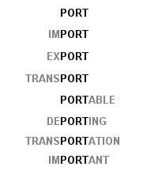
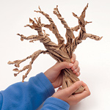
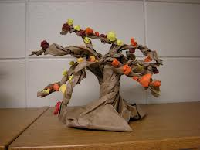
Got Some Roots?
ROOTS TREE
It is possible to create an amazing “Whomping Tree” out of a common grocery store brown paper bag.
While some educators think the tree is fun to decorate when the leaves start changing, middle school classrooms can create root trees! Directions can be found on the LUSLI website.
Prepare the tree. Choose a root, and define it. Then write words you know or look up that have the root! It’s a lot of fun.
Students think deeply about the task at hand and learn roots while collaborating with other students. The tree is not a “throw-away” item, and parents are very impressed with your artistic abilities to give students multiple ways to master vocabulary.
Source: pikadillycharm.blogspot.com

Slide 11
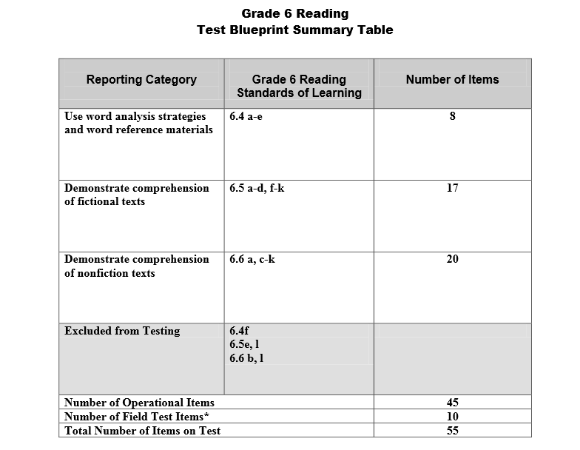
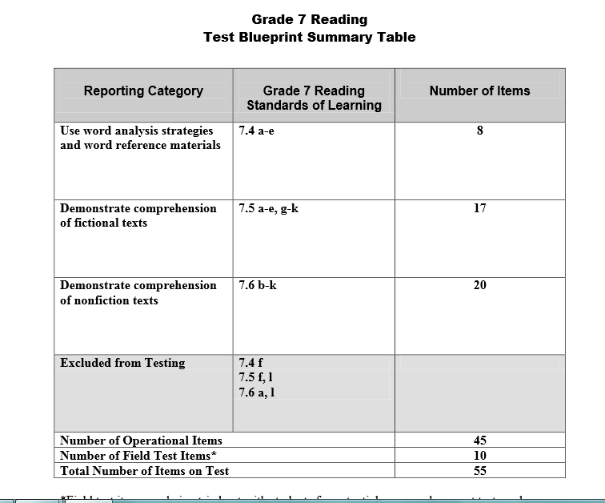
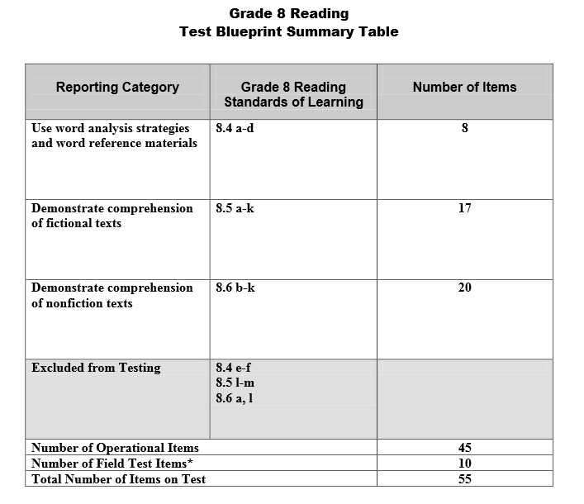
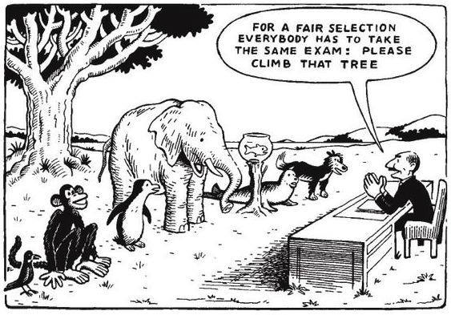
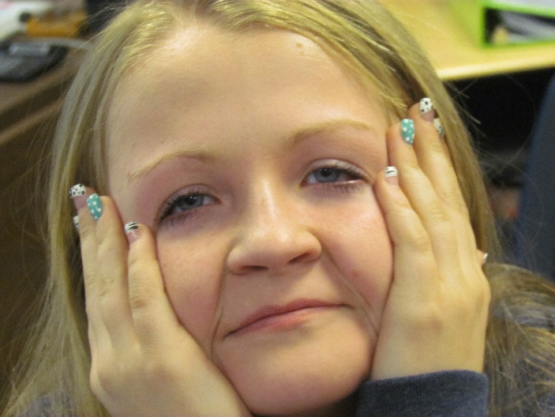
Fading Fiction?
Grade 5 = 15 fiction:17 nonfiction items
Grade 6 = 17 fiction:20 nonfiction items
Grade 7 = 17 fiction:20 nonfiction items
Grade 8 = 17 fiction:20 nonfiction items
Source: learnmegood2.blogspot.com and
© Lizbeth J. Phillips, all rights reserved

Slide 12
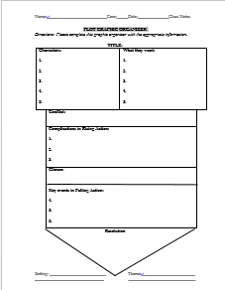
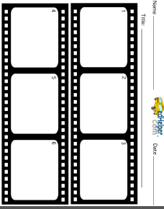
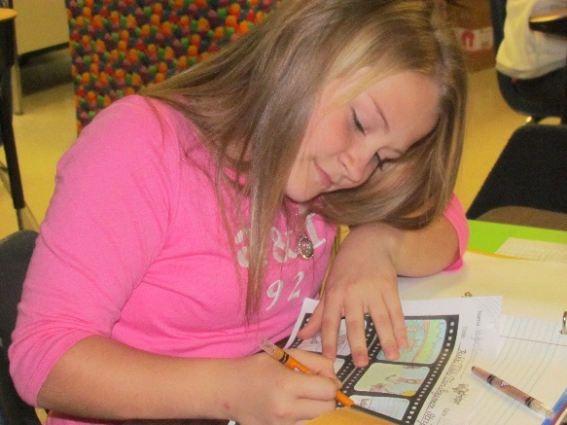
Fading Fiction?
GRAPHIC ORGANIZERS
We all know the value of a graphic organizer that helps students focus on one or more skills. We also know that using short stories supports students as they learn and review basic concepts of fiction that are important for life-long readers.
More importantly, we know that if students do not get plenty of practice, they lose the skills. This is more evident than ever as standardized testing transitions from fiction to nonfiction dominance! We cannot forget or forgo fiction!
Our two favorite graphic organizers are provided on the LUSLI web site.
© Lizbeth J. Phillips, all rights reserved

Slide 13
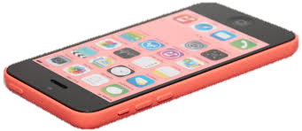
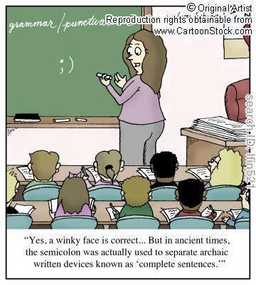
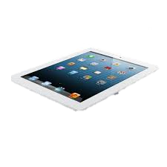
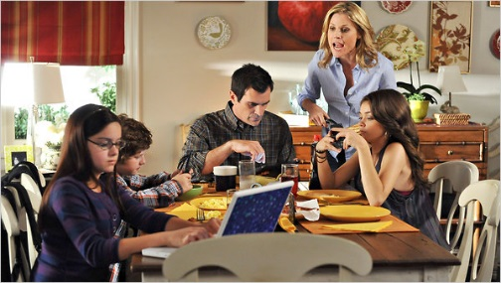
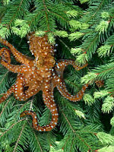
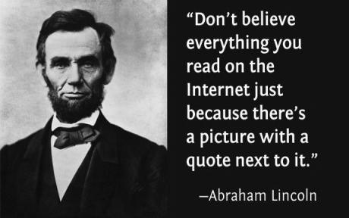
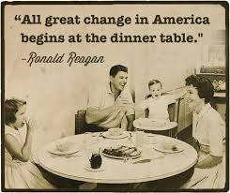
Stranger Than Fiction!
Digital Literacy?
That presents a new set of issues for educators, doesn’t it?
Rare photo of the elusive tree octopus
Source: Wordpress.com (Education blogs)

Slide 14
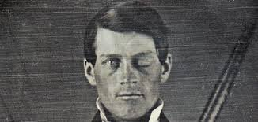
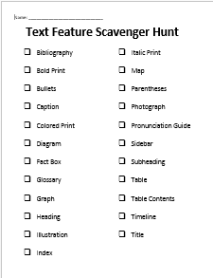
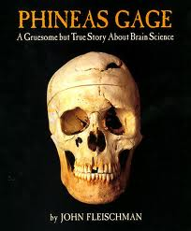
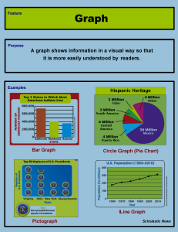
Stranger Than Fiction!
While it is a good idea to have students search their textbooks for features, we need to provide opportunities for them to discover the features in many other nonfiction formats.
John Fleishman’s nonfiction account of Phineas Gage’s life after a tragic accident reads like a story. Students are shocked when they find nonfiction features.
Hunt for nonfiction features in a copy of Phineas Gage: A Gruesome but True Story About Brain Science.
Sources: Scholastic, Inc. and Houghlton Mifflin Publishing Co.

Slide 15
Forming Ideas from Observation…
There are so many standards and so many bullets that it is hard for an educator to keep track.
Teach concepts
Provide enrichment and extra help (on the spot, on demand)
Identify students who are struggling with one or more concepts (each and every day)
Be ever mindful of student growth throughout the year
Source: Word Press.com (education)
Why is this so funny?

Slide 16
Forming Ideas from Observations
Try a graphic organizer that has your seating chart on one side so you can make notes about each student. On the other side of the organizer use a skills chart to document attempts and response to whatever intervention you offer in class.
This will help with your remediation and intervention plans (or RTIs).
This will help you keep good records of student growth for your portfolio.
© Lizbeth J. Phillips, all rights reserved

Slide 17
Writing Your Own Beeswax!
Research states that note-taking is an important part of a student’s educational journey.
How students take notes matters. According to Marzano, students who know how to use Cornell Notes tend to do better in middle and high school.
We need to model how to create Cornell Notes—especially if we have never used them ourselves.
Read the Taxidermy article. Can you format your notes to fit the Cornell style?
Source: School Outfitters

Slide 18
Does Grading Overwhelm You?
Who made you so omniscient that you HAVE TO mark EVERYTHING that’s “wrong” with an assignment? Especially if it involves writing?
Reduce your targets! Let students know exactly what you are looking for.
You get FOUR targets, and they get ONE virtue.
Yes, we know there are two letters and some words missing! Glad you noticed that our e-scanner managed to omit parts of this image.

Slide 19
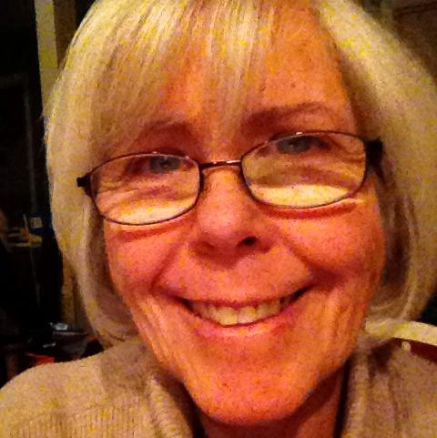
Contact Information
Liz
Liz Phillips
Literacy Specialist
Wallace Middle School
13077 Wallace Pike
Bristol, Virginia 24211
(276) 642-5400
Email: ljphillips@wcs.k12.va.us
For more lesson ideas that go with this presentation, please visit Class Web Page: lizphillips-ela.weebly.com
Blog: lizphillipsteaches.tumblr.com
Val
Valerie Leonard
English Language Arts Educator
Wallace Middle School
13077 Wallace Pike
Bristol, Virginia 24211
(276) 642-5400
Email: vleonard@wcs.k12.va.us

